Slide 1
Finding, accessing, and re-using research data
The University of Mannheim Research Data Center and BERD@NFDI

Slide 2
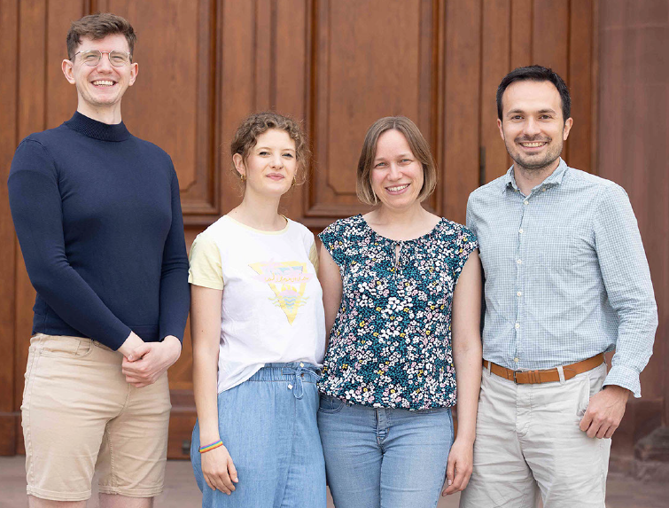
The Research Data Center (FDZ) Team
+ Phil Kolbe
(Social Sciences)
+ Tobias Rettig (GIP)
+ Anne Balz (GIP)
David Morgan
(Social Sciences, DMPs)
Renat Shigapov
(Data Scientist)
Larissa Will
(Humanities, OCR)
Irene Schumm
(Economics, Business)

Slide 3
The Research Data Center (FDZ) What we do
The FDZ supports researchers from the University of Mannheim
at all career stages and from all disciplines
in managing their research data.

Slide 4



The FDZ Services along the Research Data Cycle
Data archiving, sharing, publishing
(MADATA, MAObjects, other repositories, safe room)
Data management planning and
FAIR data management
(DMPs, funders‘ and journal guidelines)
trainings
trainings
Data cleaning, structuring, and linking
(OpenRefine, knowledge graphs)
tools
Data acquisition and collection (licenses&legal, harvesting, scraping, OCR, German Internet Panel / GIP)
support
Data offerings by FDZ
(Aktienführer, Reichsanzeiger)

Slide 5
The FDZ Services along the Research Data Cycle
Data archiving, sharing, publishing
(MADATA, MAObjects, other repositories, safe room)
Data management planning and
FAIR data management
(DMPs, funders‘ and journal guidelines)
trainings
trainings
Data cleaning, structuring, and linking
(OpenRefine, knowledge graphs)
tools
Data acquisition and collection (licenses&legal, harvesting, scraping, OCR, German Internet Panel / GIP)
support
Data offerings by FDZ
(Aktienführer, Reichsanzeiger)

Slide 6

Data Management Planning & FAIR Data Management
Data Management Plan: „[P]lans [that] support the researcher in considering all relevant aspects of data management from the very beginning of a research project. A DMP should stimulate researchers to think about optimal handling, organising, documenting, and storing of their data.”
Science Europe (2021)

Slide 7

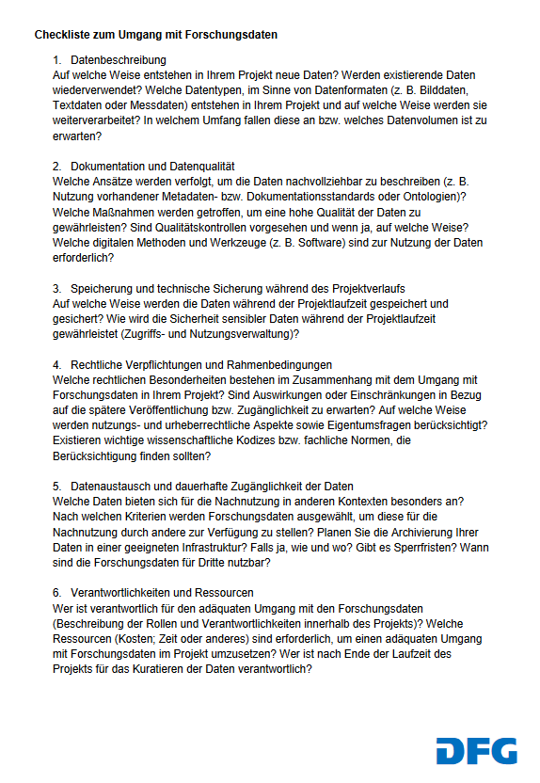



Data Management Requirements of Funders
No general policies
Call-specific RDM requirements
general checklist of DFG reg. data management
Subject-specific checklists, e.g. Sociology
No real DMP
FAIR data management
DMP mandatory within 6 months funding start

Slide 8




What goes into a DMP?
Administrative information (project name, abstract, PIs, etc.)
Data description (type, format, volume) and collection or re-use of existing data
Legal and ethical requirements
Storage and backup during the research process
Data sharing and long-term preservation
Data management responsibilities and resources
Documentation and data quality
ReadMe
§
€

Slide 9
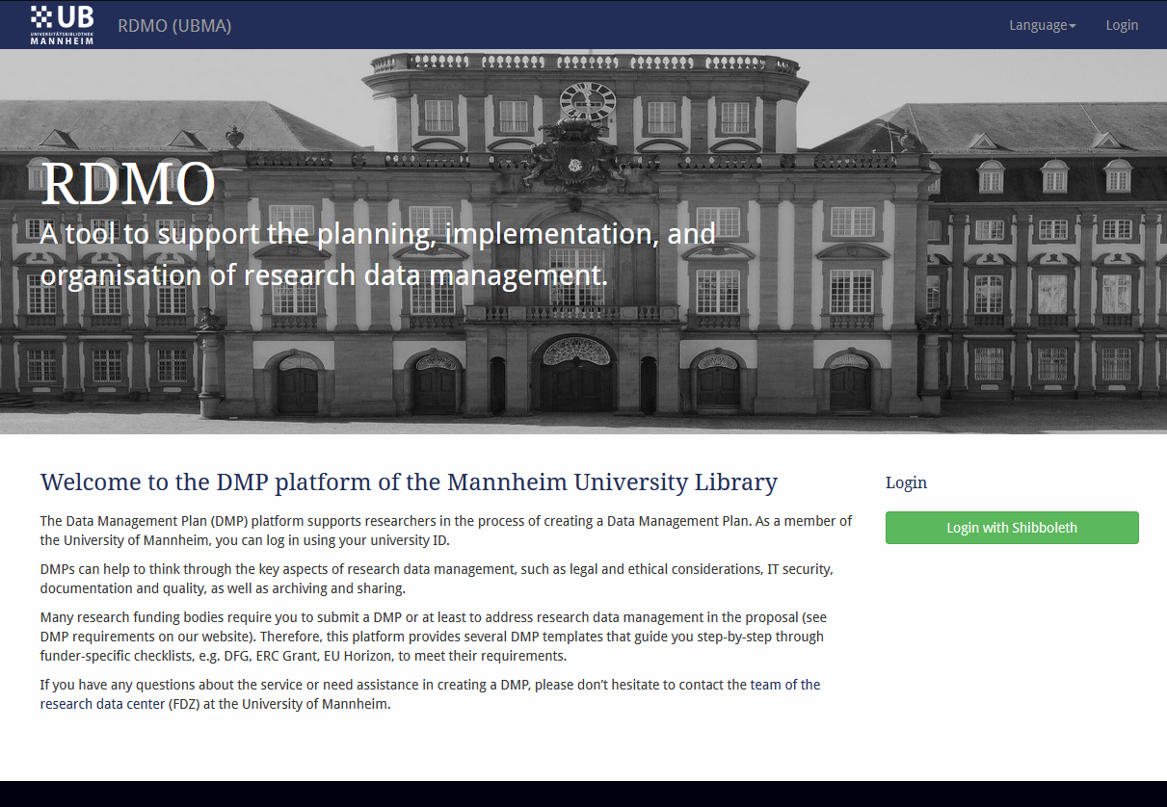
DMP Services of the FDZ DMP Platform and Workshops
DMP Workshop
by David Morgan
on 12th of December, 2pm
https://www.uni-mannheim.de/news/data-management-plan-workshop/
https://fdz.bib.uni-mannheim.de/rdmo/

Slide 10
The FDZ Services along the Research Data Cycle
Data archiving, sharing, publishing
(MADATA, MAObjects, other repositories, safe room)
Data management planning and
FAIR data management
(DMPs, funders‘ and journal guidelines)
trainings
trainings
Data cleaning, structuring, and linking
(OpenRefine, knowledge graphs)
tools
Data acquisition and collection (licenses&legal, harvesting, scraping, OCR, German Internet Panel / GIP)
support
Data offerings by FDZ
(Aktienführer, Reichsanzeiger)

Slide 11
Data Acquisition and Collection: Data Licensing Service
The Library negotiates and concludes license agreements for fee-based secondary data sources (e.g. from other research data centers, commercial data vendors)
Contact: erwerbungsleitung.ub@uni-mannheim.de
Coming soon: data catalog with an overview of licenses acquired by the University

Slide 12
Data Acquisition and Collection: Survey Data via German Internet Panel
Regular online panel survey among indiviuals in Germany since 2012
Based on a random sample of the total population of Germany (aged 16-75 at the time of recruitment, from private housholds only)
Six panel waves per year
Panel of 67 waves with more than 200.000 interviews and more than 7.500 participants (more than 3.600 have been active in the last wave)
GIP survey infrastructure implemented by former SFB 884 „ Political Economy of Reforms“
GIP transitioned to the FDZ/Mannheim University Library this year
NEW: survey space can be booked by all researchers now

Slide 13
Data Acquisition and Collection: Using the GIP Infrastructure
Process – Pre-Survey
Researcher contacts GIP with survey idea
GIP staff consults regarding feasibility, scope/costs, wording, filtering etc.
GIP staff organizes the implementation of the questionnaire
GIP staff and researcher test questionnaire
Normal „time to survey“: 3-4 months; „emergency questions“ possible under certain circumstances

Slide 14
Data Acquisition and Collection: Using the GIP Infrastructure
Process – In the Field
Survey length: 20mins maximum, modular design
Survey participants are invited via email (and reminded, as needed)
Email and telephone hotline support for participants
Participants receive incentives – plans:
25ct/min
10 € for participating in all 6 waves a year; 5 € for participating in 5 waves

Slide 15
Data Acquisition and Collection: Using the GIP Infrastructure
Process – After the Survey
GIP team receives data, does data processing and documentation
After ~1 month:
Researchers will receive their data
Report for participants with some interesting findings
After ~6 months:
Data will be published via GESIS Data Archive for secondary use
Documentation will be published via paneldata.org

Slide 16
Data Acquisition and Collection: Optical Character Recognition
The Library carried out several digitizing projects with automated text recognition → optimized data quality for research purposes
Consultation and support
Consultation hour via Zoom, Meeting-ID: 682 8185 1819 (next: 7 December, 3-4pm)
Support in optimizing digitization and OCR workflows
Data sources
(such as Aktienführer, Reichsanzeiger)

Slide 17
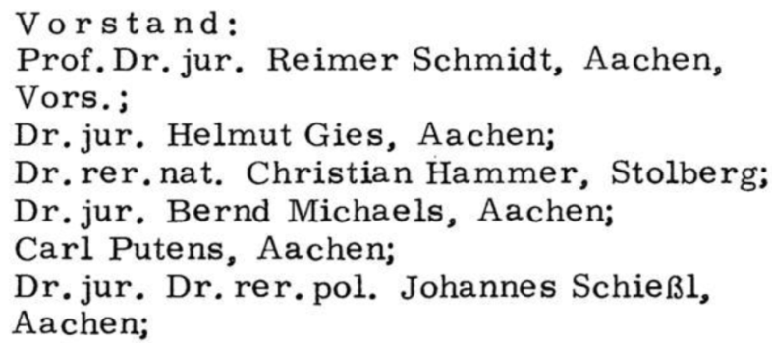
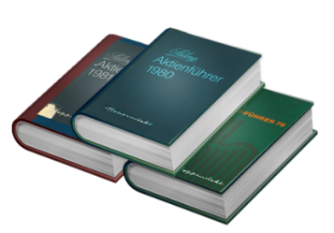
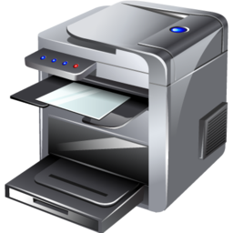
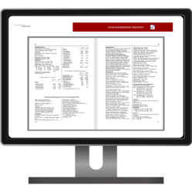
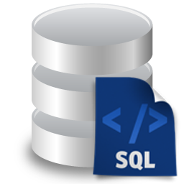
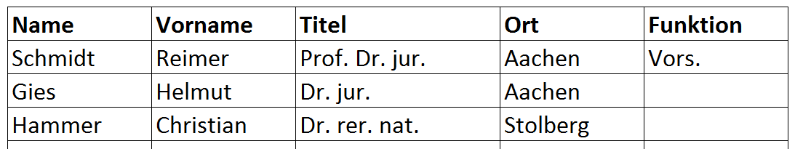
Data Acquisition and Collection: Optical Character Recognition – Data Sources
Aktienführer Data Archive 1956-2018
1. Image digitization
2. OCR fulltext recognition
3. Parsing of data structure
→ Import into database
4. Web frontend

Slide 18
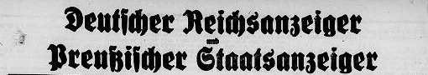
Data Acquisition and Collection: Optical Character Recognition – Data Sources
Official journal of the Prussian government and the „Deutsche Reich“
Proclamation of new laws and regulations
Public announcements
Losses during WWI
Historical commercial registers (incorporations and bancruptcies of companies)
Patent filings
…
In progress

Slide 19
The FDZ Services along the Research Data Cycle
Data archiving, sharing, publishing
(MADATA, MAObjects, other repositories, safe room)
Data management planning and
FAIR data management
(DMPs, funders‘ and journal guidelines)
trainings
trainings
Data cleaning, structuring, and linking
(OpenRefine, knowledge graphs)
tools
Data acquisition and collection (licenses&legal, harvesting, scraping, OCR, German Internet Panel / GIP)
support
Data offerings by FDZ
(Aktienführer, Reichsanzeiger)

Slide 20
Data cleaning, structuring, and linking: Knowledge Graphs
Starting from the Aktienführer Data Archive we have been acquiring and structuring more (historic and current) data sources containing company data → no data silos
Solution: create company data knowledge graphs (BERD@NFDI and FDZ) using Wikibase software
Companies, people and places related to companies as unique and identifiable entities with certain properties
linking entities within knowledge graph and beyond (Wikidata etc.)
Semantification: from unFAIR strings to interlinked FAIR entities

Slide 21
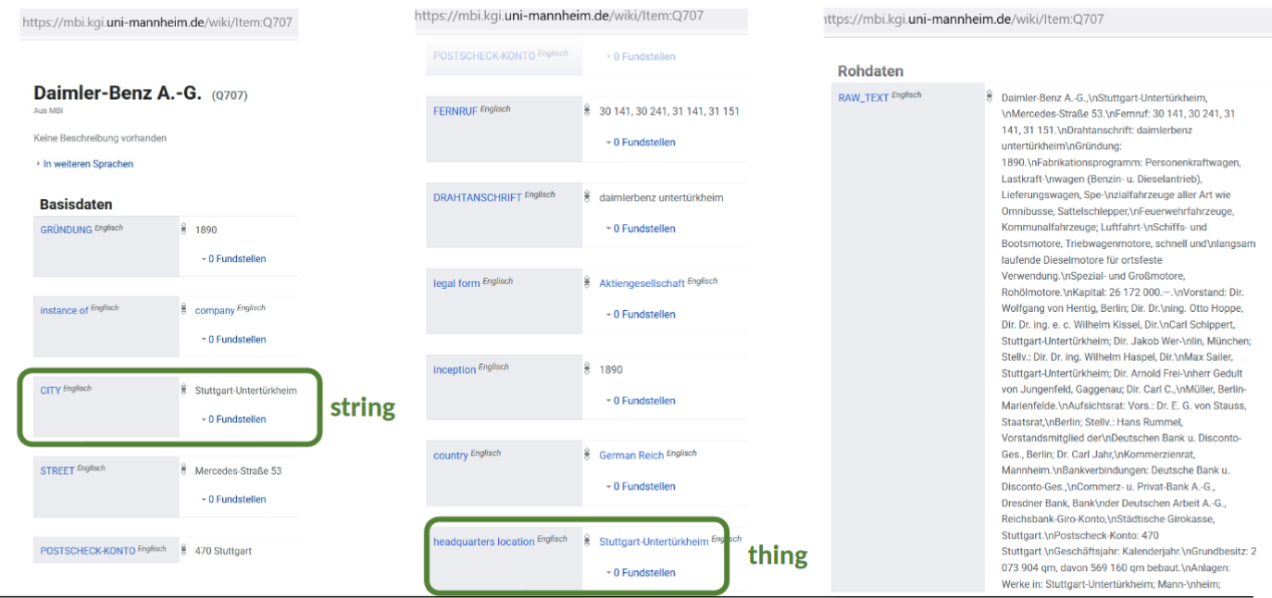
Data cleaning, structuring, and linking Knowledge Graphs

Slide 22
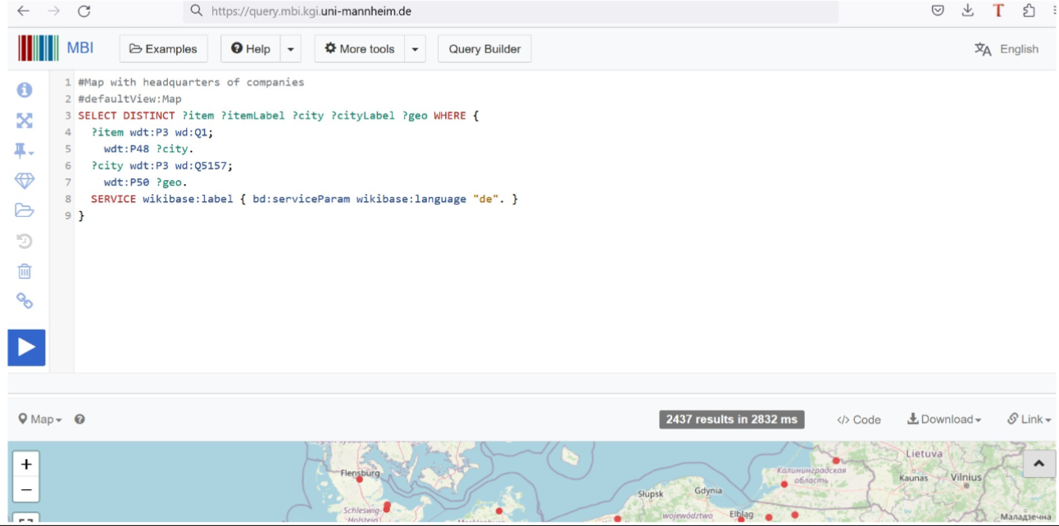
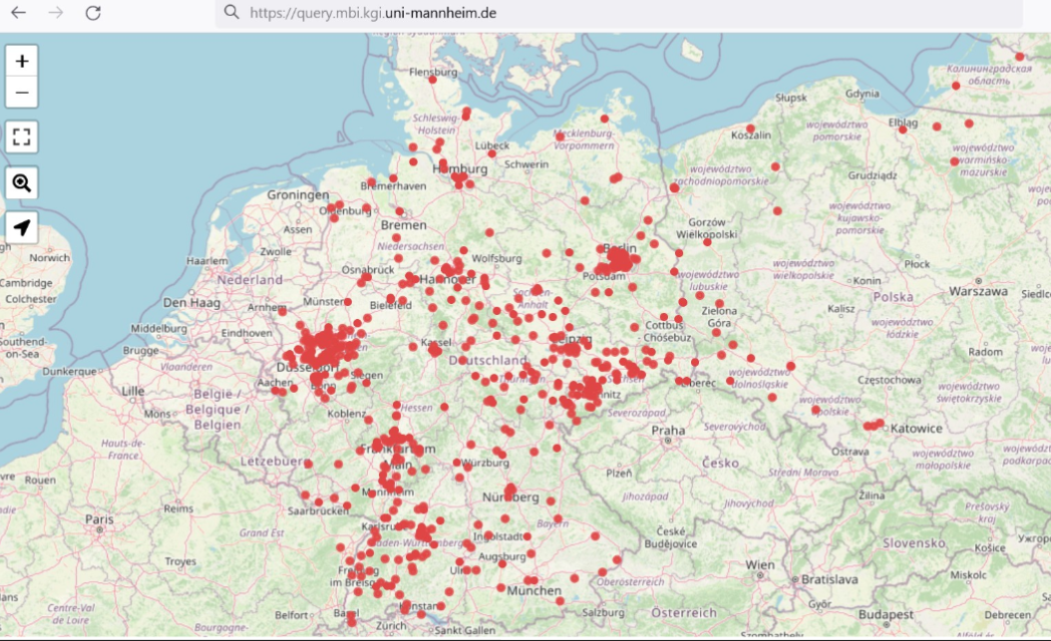
Data cleaning, structuring, and linking Knowledge Graphs
Profits of having the data in a Knowledge Graph
SPARQL endpoint for querying the KG and visualizations

Slide 23
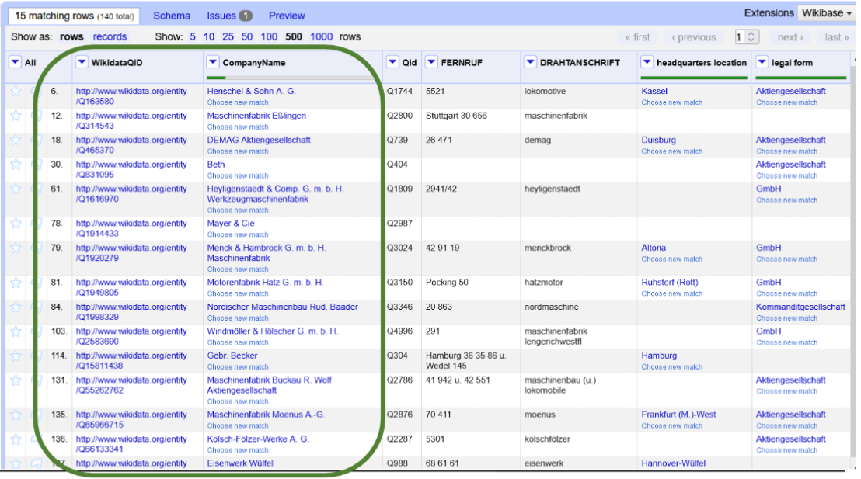
Data cleaning, structuring, and linking Knowledge Graphs
Profits of having the data in a Knowledge Graph
SPARQL endpoint for querying the KG
Linking to and from other KGs
Enriching tabular data using KGs

Slide 24
Data cleaning, structuring, and linking Knowledge Graphs
Profits of having the data in a Knowledge Graph
SPARQL endpoint for querying the KG
Linking to and from other KGs
Enriching tabular data using KGs
We support you creating your own KG!
„Knowledge Graphs for Research“ talk by Renat Shigapov on 5th of December, 2pm, https://www.uni-mannheim.de/news/knowledge-graphs-for-research/

Slide 25
The FDZ Services along the Research Data Cycle
Data archiving, sharing, publishing
(MADATA, MAObjects, other repositories, secure data room)
Data management planning and
FAIR data management
(DMPs, funders‘ and journal guidelines)
trainings
trainings
Data cleaning, structuring, and linking
(OpenRefine, knowledge graphs)
tools
Data acquisition and collection (licenses&legal, harvesting, scraping, OCR, German Internet Panel / GIP)
support
Data offerings by FDZ
(Aktienführer, Reichsanzeiger)

Slide 26
Data archiving, sharing, publishing MADATA and Secure Data Room
MADATA: institutional repository for archiving and/or sharing data
Data description using common metadata standard (DataCite/da|ra)
Digital Object Identifier (DOI) registered via GESIS‘ da|ra agency
Metadata indexed by GESIS data search, DataCite, Google, Google Dataset Search and soon EU‘s OpenAIRE search
Data stays on the servers of the University of Mannheim
Data sharing modes: open data, data available upon request, embargoed open data
Data will be kept for at least 10 years in line with standard requirements of funders
FDZ‘s secure data room coming soon: to grant researchers on-campus access to data that should not leave the University

Slide 27
THANK YOU
More info on
https://fdz.bib.uni-mannheim.de

